Slide 1


Slide 2


Slide 3

Samhaz and Mpofu Airline Reservation System:
A Simple Flight Booking System Using Linked Lists and Seat Management
Bhekumuzi(24bca10003) and Craig(24bca10325)
Date: 03/03/25
CS
by Samhaz and Bheki

Slide 4

Introduction to the Program
This program is designed to simulate an airline reservation system.
It manages flight bookings, tracks seat availability, and manages a waitlist.
It uses basic C structures and linked lists to manage passenger data.
The system handles seat assignments, waits for availability, and calculates estimated arrival times.

Slide 5
Program Overview
Features of the Program:
Booking a ticket.
Displaying current bookings.
Assigning seats dynamically to passengers.
Automatically calculating the Estimated Time of Arrival (ETA) based on a given departure time and distance.
Main Components:
Waitlist: Linked list structure to store passenger details.
Seat availability: A simple array to track seat occupancy.

Slide 6
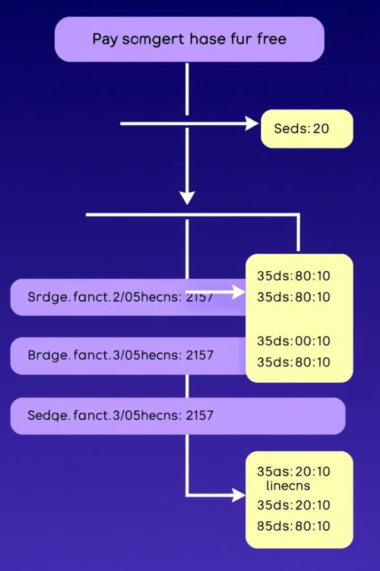
Structure Definitions
typedef struct Waitlist { char name[50]; int age; char flight[10]; char departureLocation[50]; char destinationLocation[50]; char departureTime[20]; char estimatedArrivalTime[20]; float distance; char seatNumber[5]; struct Waitlist* next; } Waitlist;
This structure holds all the passenger's details such as name, age, flight details, and seat information.
It also includes a pointer to the next node to create a linked list.

Slide 7
Seat Management
Seat Availability:
bool seatMap[TOTAL_SEATS]: An array that tracks seat availability. false means the seat is available.
There are 30 seats, which are mapped to rows (1-15) and columns (A and B).
Assigning Seats:
const char* assignSeat() { static char seat[5]; for (int i = 0; i < TOTAL_SEATS; i++) { if (!seatMap[i]) { int row = i / 2 + 1; char seatLetter = (i % 2 == 0) ? 'A' : 'B'; sprintf(seat, "%d%c", row, seatLetter); seatMap[i] = true; // Mark seat as taken return seat; } } return NULL; // No seats available }
This function assigns the next available seat and returns the seat number (e.g., "12A").

Slide 8
Ticket Booking Function
The bookTicket() function:
Collects passenger details (name, age, flight, departure location, etc.).
Automatically calculates the ETA based on the departure time and distance.
Assigns a seat dynamically.
Adds the passenger to the waitlist if a seat is not available.
ETA Calculation Example:
Distance: 1000 km.
Average speed: 500 km/h.
The estimated travel time is 2 hours, and the ETA is calculated based on the departure time.

Slide 9
Booking Details and Waitlist
After booking a ticket:
Passenger information, including seat number and flight details, is printed.
If no seats are available, passengers are placed on the waitlist.
Waitlist Linked List:
Each booking is added as a new node in the waitlist linked list.
New passengers are added at the end of the list, maintaining the order of arrival.

Slide 10
Main Menu and User Interaction
The main() function presents a simple menu to the user:
Book a ticket.
Display all bookings.
Exit the program.
User selects an option to either book a ticket, view all bookings, or exit.

Slide 11
Conclusion
This simple airline reservation system demonstrates:
How to use structs and linked lists to manage data.
Dynamic seat allocation and waitlisting.
Basic flight booking logic, including ETA calculation.
Limitations:
It assumes a static seat map (no dynamic seat configuration).
The ETA calculation is simplified and does not account for real-world factors (like delays).
Further improvements could include:
Adding user authentication.
Managing multiple flights with separate seat maps.
Implementing advanced scheduling features.

Slide 12

Questions & Discussion
Thank you for your attention!
Any questions or suggestions?

